Slide 1
Cyber Security Models

Slide 2
Introduction
Various organizations and companies that deal with the critical and sensitive data require the security policies and security models.
To ensure the fulfillment of security principles like confidentiality, authentication etc.
Security policy is a well defined set of rules that provide the guidelines for the nature of behavior of different entities that are related to the organization.

Slide 3
Introduction
These entities are given as follows-
Subjects: agents that interact with the system, e.g., end user or internal employee of the organization.
Objects: entity which is to be protected from the inside or outside attack. e.g., user credentials or application code or any top secret file.
Actions: the operations that are related with the objects like reading the contents of the file or accessing the database system.
Permissions: It maps the subjects, objects and actions stating that which operation is allowed on which objects by which subjects.
Protections: security rules that ensure the achievement of security policies like confidentiality, authentications, integrity, access control etc.

Slide 4
Security Principles
Security Principle | Description | Compromising Attack | Security Solution
Confidentiality | Only intended recipient must be able to access the message that has been sent secretly | Interception | Symmetric key algorithms like DES, AES or IDEA and Asymmetric key algorithms like RSA
Integrity | Contents of the message must not be altered by any means | Modification | Message Digest algorithms like SHA, MD5
Availability | Services must be available to the legitimate users for all the time | Denial-of-Service | Detection and prevention systems for Denial-of-service
Authentication | The sender of the message must be properly identified. | Fabrication | Digital Signatures
Non-repudiation | One must not refuse transmission of the message | Refusal of transmission | Digital Signatures
Access Control | Which user can access what service or object that has to be defined properly | Unauthorized Access | Access Control Matrix

Slide 5
Security Models

Slide 6
Access Control Matrix
Ensures authorization for accessing certain resources placed in a secure environment.
Entity that tries to access the resources is known as subject.
Resources that are accessed by subjects are known as objects.
A set of rights specifies the mode of operations allowed to be performed on particular object by certain subject.

Slide 7
Access Control Matrix
Access control matrix gives details that which subject has which right over which object.
There are two ways to implement access control matrix:
Access control list
Capability tables.

Slide 8
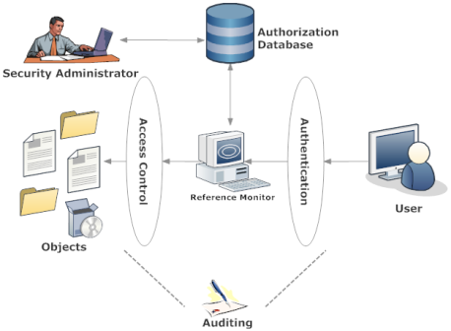
Access Control Matrix
Figure I. Access Control and other security operations

Slide 9
Access Control Matrix
The table gives the access control matrix for user A and B:
 | Objects
Subjects | File1 | File2 | File3
User A | Read, Write, Execute | Read | Write
User B | Read | - | Execute
Three access control mechanisms are available:
Mandatory access control mechanism
Discretion access control mechanism
Role-based access control
Any combination of these methods can be used as security mechanism as long as it does not contradict the other mechanism.

Slide 10
Access Control Matrix: Shortcomings
In some case Access Control Mechanisms may not work sufficiently for proper authentication purposes.
For example,
for a certain file, there can be more authorization rights to some user who is at higher level than the owner of the file.
Owner may want to share or restrict the file from certain users.
But manager of the owner may not want to flow this information through all users.

Slide 11
Capability based Security Model
Provides security against unauthorized access to the system objects.
Capability is awarded to the user as a token of authority in terms of various rights on the objects.
When user logs into the systems, they have to use the capability to access the particular object.
This way can be to read the file, or to write into the file or execute the program or even delete the file.

Slide 12
Capability based Security Model
Users can directly share the capability with other users as per the requirement of those users.
Capability references the object with associated set of access rights.
For implementing this capability lists secure data structures are used.
This data structure includes the object name that is to be kept secure from unauthorized access.

Slide 13
Capability based Security Model
Data structures used are cannot be forged or attacked by any program running in the operating system
Various operations are possible on the capability list by the programs that possesses it.
The operations include:
passing the capability to other programs;
convert these capabilities to other less privileged form;
These operations have to be kept secure to maintain the integrity of security policy.

Slide 14
Mandatory Access Control
Here, security kernel of the operating system restricts and constrains operations performed by subjects on objects.
Subjects in this case can be any process or thread and objects can be files, database, TCP/IP ports etc.
This mandatory access control mechanism is also called as multi-level security models.
Basic rule concerning to this multi-level security is that security level of subject who is accessing the data must be at least as high as security level of data.

Slide 15
Figure II. Various Access Security Mechanisms

Slide 16
Discretionary Access Control
Restrictions over the subjects to access the objects are based upon the identity of the subject or group of subject to which they belong.
Authority of the objects is decided by the owner and other subjects that authority line goes directly to the owner.
Subject has complete control over the programs it owns and executes.
Vulnerabilities are inherent into the system such as:
Trojan horse
Maintaining, monitoring and managing the access control list is difficult
Scalability issues

Slide 17
Role based Access Control
Access to information or any secured file is given on the basis of the role of the user.
Many users may have one role and therefore same authority rights that is assigned to that role.
These roles can be changed to different roles at different time.
In some RBAC, one user allowed having different roles and in other RBAC it is restricted to only one role per user.

Slide 18
Role based Access Control
Tasks related to authorization are separated from the access control mechanism.
Functions performed in authorization include assigning the role based on user credential and assigning access rights to the specific roles.

Slide 19
Role based Access Control
In IT company software engineer may not have any access to the managerial files like financial budget etc.
But, manager may have more access levels to all the managerial files as well as to those are created by software engineer.
Figure III. Hierarchy of in
IT Company

Slide 20
Lattice-based Access Control
Label-based mandatory access control in which lattice, a concept in graph theory, is used to define levels of security that are required to assign the access rights to subjects to access the objects.
User or subject can access the resource or object only if security level of subject is greater than security level of object.
Lattice is a partial ordered set where elements of the set have greatest lower bound (meet) and least upper bound (join).

Slide 21
Lattice-based Access Control
For example, in the lattice shown in the figure, upper bound of node {A} and {B} is both {A,B,C} and {A,B}. But, least upper bound is {A,B}.
Figure IV. Lattice for “is subset of”

Slide 22
Lattice-based Access Control
In LBAC, lattice is used as follows:
If there are two subjects, S1 and S2, that needs the access of some object. Then, security level is defined as meet of the levels of two subjects.
If there are two objects, O1 and O2, that are combined together to form another object O, then O is accessible to the subject that is located at the level of join of O1 and O2.

Slide 23
Context-based access control
Used in firewall mechanism that filters the network traffic.
It filters the traffic related to network layer, transport layer, session layer and application layer.
It is stateful as well as application firewall that filters the traffic based on their:
IP addresses and protocols, ports;
TCP and UDP sessions,
state of the conversation,
protocols for specific applications,
multi-channel applications like FTP;

Slide 24
Context-based access control
Most of the multimedia protocols as well as some other protocols such as FTP or RPC, involve multiple control channels.
It can work in intranets, extranets as well as internets.
CABC allows the access based on their state information.
It performs deep packet inspection and also termed as IOS firewall.
With the help of CBAC, denial-of-service attack can be prevented and detected successfully.

Slide 25
Context-based access control
For example, as shown in the figure, when user connects to the internet, it is always through some router. Firewall software that is using CBAC can be installed in such router. When user sends some request to remote server via Internet, it has to through this router. These firewalls can permit the traffic which is originated from within the network needing protection.
Figure V. Context-based Access Control

Slide 26
State Machine security model
Uses finite state machine for securing the computer systems from the malicious attacks.
Finite state machine consists of various states that define the value of the various important variables at particular point of time.
Also, it includes transitions of the machine from one state to another state.
This transition is allowed only when some criteria are fulfilled or some input is given to the system.

Slide 27
State Machine security model
When finite state machines are used in security models, first we need to find out states that are safe and secure.
When system transits from one state to another state security manager also has to take care that it preserves this secure state.
This model continuously check for the system to not to fall into insecure state.
The state machine concept serves as the basis of many security models.
The model is valued for knowing in what state the system will reside.

Slide 28
State Machine security model
For example, electric button has two states as ON and OFF with the input of pressing the button. Button goes to another state from ON to OFF after input event is occurred. Figure shows typical state machine diagram.
Figure VI. State Machine Diagram

Slide 29
Information Flow model
Used to secure the systems from unauthorized accessed and attacks.
It is a slight extension of the state machine model.
It consists of objects, state machines, state transitions and lattice.
Main objective of information flow model is to control the information flow originating from one state and directed to another state.
To achieve this constraints are employed over the flow of information in terms of guards.

Slide 30
Information Flow model
The figure shows the information flow model diagrammatically. For example, security level is assigned to each and every subject and object. Accordingly their states are fixed at particular point of time. And guards are used on the basis of security level of requesting subject and security level of requested object.
Figure VII Information Flow Model

Slide 31
Bell and LaPadula Model
This model basically formulizes mandatory access control.
It combines DAC with MAC to ensure the enforcement of security policies.
BLP works in a two states approach-
Access control matrix, D, is created which works on the principle of discretionary access control.
Operations that are carried out on the objects by the subjects are authorized by using mandatory access control. Users cannot have any control over the operations.

Slide 32
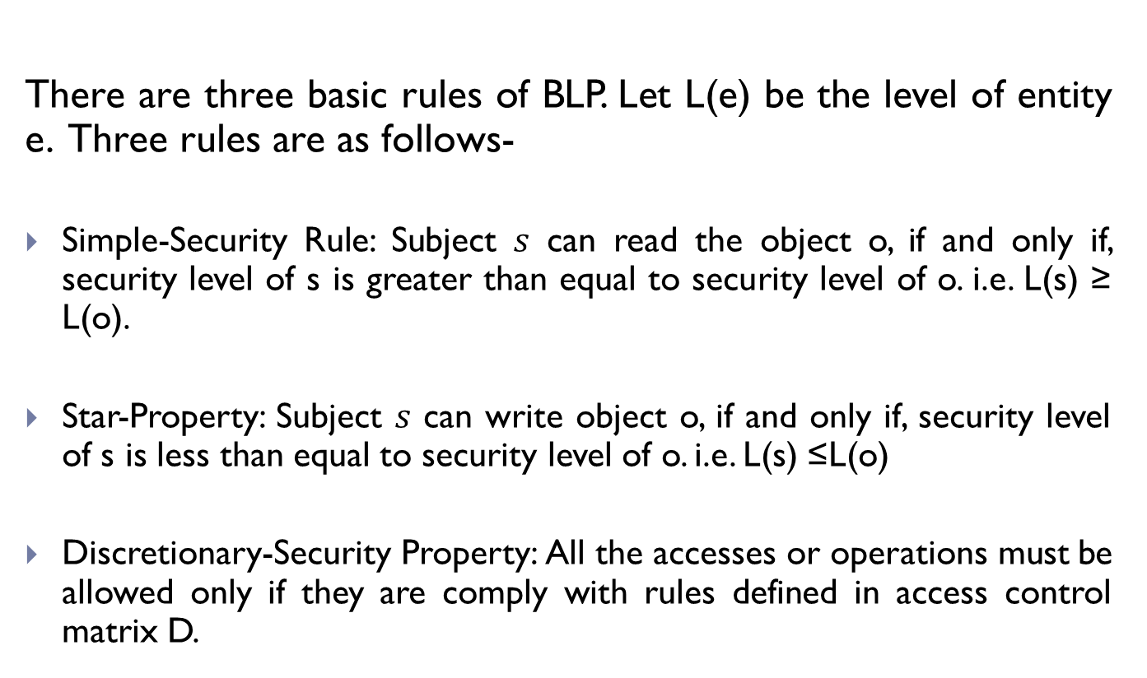
Bell and LaPadula Model
There are three basic rules of BLP. Let L(e) be the level of entity e. Three rules are as follows-
Simple-Security Rule: Subject $s$ can read the object o, if and only if, security level of s is greater than equal to security level of o. i.e. L(s) ≥ L(o).
Star-Property: Subject $s$ can write object o, if and only if, security level of s is less than equal to security level of o. i.e. L(s) ≤L(o)
Discretionary-Security Property: All the accesses or operations must be allowed only if they are comply with rules defined in access control matrix D.

Slide 33
Bell and LaPadula Model
According to the BLP rules, subject at security level confidential cannot read the objects at the security level secret, because to read the contents of the objects, subject has to be of greater security level (Simple-security rule). Also, subject at security level confidential cannot write the objects at the security level unclassified, because to read the contents of the objects, subject has to be of lower security level (star property).
Figure VIII. Bell-LaPadula Model

Slide 34
Biba Integrity model
Since BLP cannot addresses the issues related with integrity of secured information and can only provide confidentiality.
Biba model assigns integrity levels to the subjects and objects involved in the system.
Integrity level denotes the trustworthiness of entity to which it is assigned
The basic principle that is followed in Biba model is that low-integrity information should not be allowed to flow to high-integrity objects.

Slide 35
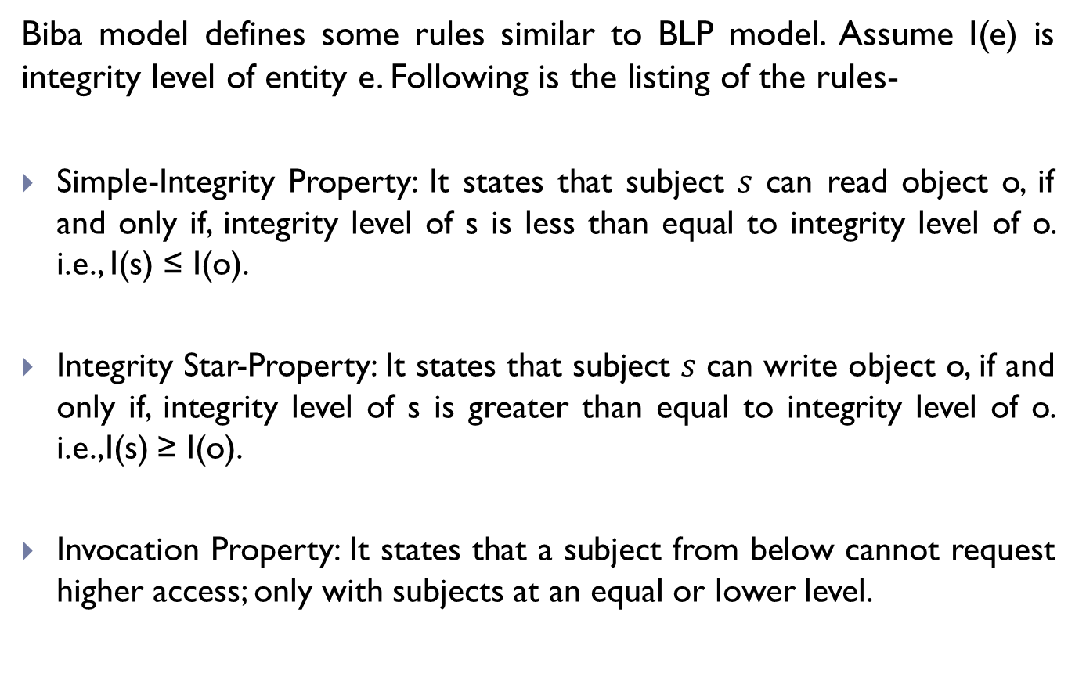
Biba Integrity model
Biba model defines some rules similar to BLP model. Assume I(e) is integrity level of entity e. Following is the listing of the rules-
Simple-Integrity Property: It states that subject $s$ can read object o, if and only if, integrity level of s is less than equal to integrity level of o. i.e., I(s) ≤ I(o).
Integrity Star-Property: It states that subject $s$ can write object o, if and only if, integrity level of s is greater than equal to integrity level of o. i.e.,I(s) ≥ I(o).
Invocation Property: It states that a subject from below cannot request higher access; only with subjects at an equal or lower level.

Slide 36
Biba Integrity model
The figure explains the rules involved in Biba model. Arrow direction in figure indicates the information flow between different entities. We can see from the figure that high integrity subject cannot read the low integrity object (simple-integrity property), but low integrity subject can read the high integrity object but cannot write (integrity star-property).
Figure IX. Biba Model

Slide 37
Low Water-Mark Mandatory Access Control Model
Mandatory access control model which preserves the integrity of the system using information flow policy.
The integrity labels can be made up of one or more than one hierarchical grades, depending on their types.
Partial order of integrity labels is created to form a lattice like structure.
Edges of the lattice may represent the information flow.
Subjects are allowed to read the objects that have higher integrity label, but they can only be allowed to write the objects if it is of low integrity label.

Slide 38
High water-mark model
Preserves the access control.
Security level is assigned to each and every entity i.e. all subjects and objects, according to their trustworthiness and importance.
User can open the document, file or any other object if and only if that object is having security level less than or equal to the user who is accessing that object.
This will ensure that no other user will able to access the same object that is being currently accessed by another user.
The practical effect of the high-water mark was a gradual movement of all objects towards the highest security level in the system.

Slide 39
Clark-Wilson security model
It ensures the integrity of the information that is flowing through the organization’s network.
It ensures that no unauthorized user can access the information to modify it by any means.
Integrity of the information ensures that system remains in consistent state after it transitions from one system to another.
Clark Wilson model is focused in commercial business operations and not just for military and intelligence system

Slide 40
Clark-Wilson security model
This model discusses that any commercial integrity model should posses following four properties-
Authentication: Every user of the system must be properly authenticated by granting the access after they provide some user credentials.
Audit: All the activities, operations of the system and modifications in the data should be logged into the files for analysis purpose.
Well-formed Transaction: It refers to the fact that every transaction carried out in the system should maintain the consistency of the system.
Separation of Duty: the user which implements the program that is associated with it and certifier of the transaction are different entities.

Slide 41
Clark-Wilson security model: Datatypes Used
Data Type | Description
Constrained Data Items (CDIs) | CDIs are the objects whose integrity is protected
Unconstrained Data Items (UDIs) | UDIs are objects not covered by the integrity policy
Transformation Procedures (TPs) | TPs are the only procedures allowed to modify CDIs, or take arbitrary user input and create new CDIs. Designed to take the system from one valid state to another.
Integrity Verification Procedure (IVPs) | IVPs are procedures meant to verify maintenance of integrity of CDIs.

Slide 42
Clark-Wilson security model: Certification and Enforcement Rules
Rule | Description
C1 | All IVPs must ensure that CDIs are in a valid state when the IVP is run.
C2 | All TPs must be certified as integrity-preserving.
C3 | Assignment of TPs to users must satisfy separation of duty.
C4 | The operation of TPs must be logged.
C5 | TPs executing on UDIs must result in valid CDIs.
E1 | Only certified TPs can manipulate CDIs.
E2 | Users must only access CDIs by means of TPs for which they are authorized.
E3 | The identify of each user attempting to execute a TP must be authenticated.

Slide 43
Chinese Wall Model
It provides information security access control and it is built on information flow model.
It can change the access rights dynamically according to the need.
This model provides the solution that can satisfy the conflicting interests of two organizations.
In this model, information cannot flow between subjects and objects if it is creating any conflict of interest.
In most of the commercial organizations, database related to files or any other official information is stored in hierarchical form.

Slide 44
Chinese Wall Model
In Chinese wall model, it is assumed to be three levels of hierarchy, as shown in the figure. They are called as conflict of interest classes. . For example, if user possesses the dataset A2, from the figure xx, then requesting the dataset A3 may become conflict of interest. If user asks for the dataset C3, it should get the access since there is no conflict of interest.
Figure X. Database Hierarchy

Slide 45
Graham-Denning model
Used to assign access rights to the subjects and objects and ensure the proper authorization carried out in the system.
It also ensures that objects and subjects are securely created and deleted.
This model has some protection rules that are to be followed to ensure the proper functioning of the system.

Slide 46
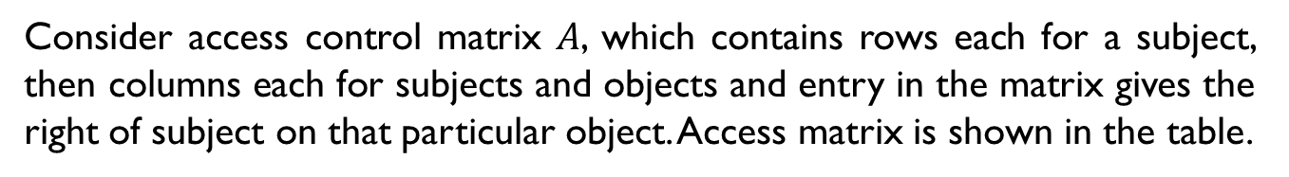
Graham-Denning model
Consider access control matrix $A$, which contains rows each for a subject, then columns each for subjects and objects and entry in the matrix gives the right of subject on that particular object. Access matrix is shown in the table.
 | Objects
Subjects | S1 | S2 | S3 | O1 | O2 | O3
S1 | Control |  |  | Owner | Read Write
S2 |  | Control | Read* |  |  | Execute
S3 |  |  | Control |  | Owner

Slide 47
Harrison-Ruzzo-Ullman model
It deals with the integrity of the access rights in the computer system.
It extends the concept of Graham-Denning model.
It is also based on the idea of finite set of procedures to edit the access rights of particular subject on particular objects.
This model is defined by three parameters namely subjects S, objects O and access matrix A

Slide 48
Harrison-Ruzzo-Ullman model
Access matrix A consists of one row for each subject and one column for each subject and object.
Entry in the access matrix is the subset of the generic rights R.
This model also consists of set of commands C, that are composed of primitive operation and pre-conditions.
If all preconditions are satisfied then only operations can be carried out.
Each command has at least one operation.
Commands that have only one operation are called as mono-operational command.

Slide 49
Harrison-Ruzzo-Ullman model
In this model, primitive operations are the ones which are operated on the subjects and objects.
There are six primitive operations defined in the following list:
Enter r into A
Delete r from A
Create subject s
Delete subject s
Create object o
Delete object o

Slide 50
Take Grant Protection Model
Used to find out whether particular computer system is safe or not.
It shows the algorithm that this model is using is decidable in linear time.
This model uses directed graph to represent the system.
Vertices in the directed graph represent the subjects or objects.
Edges between the vertices are labeled and labels indicate rights that source of the edge can have over the destination of the edge.

Slide 51
Take Grant Protection Model
Following are the rules that are followed for the accessing the rights to the requesting subjects or objects:
Take Rule: This allows a subject to take the rights of another object.
Grant Rule: This allows a subject to grant rights of his own to another object.
Create Rule: This allows a subject to create the new objects.
Remove Rule: This allows a subject to remove rights it has over on another object.

Slide 52
Take Grant Protection Model
Figure below shows the example for take grant model as a directed graph. It shows four subjects or objects A, B, C and D. Edges between the vertices has the labels indicating the rules between the two subjects. Rule between A and B is take, rule between A and C is grant and rule between A and D is just transfer of particular rights, as read and write.
Figure XI. Take Grant Protection Model: Directed Graph

Slide 53
Non-interference model
Establishes the boundaries for security levels to avoid any interference of the higher security level transactions with the lower security level transactions.
This is in contrast with the information flow model, where information flows between the two different security levels.
This model represents the data or user as low and high.
Low data means lower security level, not classified data and high data means the higher security level and classified data.
Non-interference property is satisfied only when low user gives the low input to the system and produces low output.
This strict separation of the security levels minimizes the risk of leakage of the data through covert channel.
The policy that this model loads on the computer system is very strict and considered to be stronger than other techniques.

Slide 54
Protection rings
Used to secure the data and resources from unauthorized access by maintaining the hierarchy of protection levels.
Protection ring is considered to be one of the layer or level of privilege or access within the architecture of computer system.
These rings are arranged in hierarchy from most privileged level to lowest privileged level.
Programs or users at lower privilege level may access the data at higher privilege level only under predefined rules and conditions.

Slide 55
Protection rings
On most operating systems, Ring 0 is the level with the most privileges and interacts most directly with the physical hardware such as the CPU and memory. Figure below shows example of protection ring.
Figure XII. Protection Ring

Slide 56
Summary of Security Models
Security Model | Description | Related Security Policy
Access Control Matrix | It specifies the access rights (read/write/execute) to certain users for certain resources | Authorization, Access Control
Capability-based Security | In this model capability is determined for the user at the time of logging, and based on that capability user can access the various resources. | Access Control
Mandatory Access Control | Access control is managed and monitored by security administrator. Which decides the access rights of other users | Authorization, Access Control
Discretionary Access Control | Access control is managed by owner or other subjects that have valid user credentials, and these users can manipulate the access rights of other users. | Authorization, Access Control
Role-based Access Control | Access rights are given to the user based on their role category. Management and monitoring becomes simple | Authorization, Access Control

Slide 57
Summary of Security Models
Security Model | Description | Related Security Policy
Lattice-based Access Control | Lattice is used to define the rules of access to the objects. Meet of the two subject levels give the accessible object and join of the two objects give the level of subjects that can access both of the object | Authorization, Access Control
Context-based Access Control | Network traffic can be filtered using this method. Information regarding outgoing traffic is stored in routers and incoming traffic is filtered based on that. | Traffic Inspection and Filtering, Intrusion Detection
State-Machine Model | Uses finite state machine and controls all the states and transitions from entering into non-secure state | Access Control, Safety
Information Flow Model | It controls the information flow between one subject to another only if guards are allowed to make the information flow. | Authorization, Access Control
Bell-LaPadula Model | Information flow is restricted with use security labels and simple-security rule, star property and discretionary access control principles | Confidentiality, Access Control

Slide 58
Summary of Security Models
Security Model | Description | Related Security Policy
Biba Model | Accesses and information flow is granted on the basis of integrity levels. | Confidentiality, Integrity
Low Water-mark Mandatory Access Control | This model preserves the integrity of the system by enforcing the rules about integrity levels using partial ordered set of all subjects depending on their integrity levels. | Integrity
High Water-mark Model | Access is given to the object of less than equal to security level, and level changes to highest security level currently open object | Access Control
Clark Wilson Model | Based on certification rules and enforcement rules, permissions are granted to the data accesses to ensure the data integrity in the presence of well-formed transactions | Confidentiality, Integrity
Chinese Wall Model | Access to the information related to the commercial corporations is granted on the basis of their conflict of interests | Access Control, Integrity

Slide 59
Summary of Security Models
Security Model | Description | Related Security Policy
Graham-Denning Model | It uses eight protection rules on creation, deletion, granting read, write access to/on subject and objects to ensure the access control in the system | Access Control
Harrison-Ruzzo-Ullman Model | It is the extension of Graham-Denning model and introduces the concept of commands and set of rights and notion of safe commands. | Authorization, Safety
Take Grant Protection Model | It uses directed graph to represent the system with take and grant as label of the edges of the graph. It ensures the safety of the system by making the algorithm decidable in linear time | Authorization, Safety
Non-Interference Model | It restricts the access to/from different security levels by maintaining strict separation rules. | Access Control
Protection Ring | In this model, hierarchy of the security level is maintained and access is given with special permission. | Access Control

Slide 60
References
[1] | Bowen, P., Hash, J., & Wilson, M. (2006). Information security handbook: a guide for managers. US Department of Commerce, Technology Administration, National Institute of Standards and Technology.
[2] | Sandhu, R. S., & Samarati, P. (1994). Access control: principle and practice. Communications Magazine, IEEE, 32(9), 40-48.
[3] | Lindqvist, H. (2006). Mandatory access control. Master's Thesis in Computing Science, Umea University, Department of Computing Science, SE-901, 87.
[4] | Sandhu, R. S. (1993). Lattice-based access control models. Computer, 26(11), 9-19.
[5] | Ferraiolo, D. F., Sandhu, R., Gavrila, S., Kuhn, D. R., & Chandramouli, R. (2001). Proposed NIST standard for role-based access control. ACM Transactions on Information and System Security (TISSEC), 4(3), 224-274.
[6] | Corrad, A., Montanari, R., & Tibaldi, D. (2004, August). Context-based access control management in ubiquitous environments. In Network Computing and Applications, 2004.(NCA 2004). Proceedings. Third IEEE International Symposium on (pp. 253-260). IEEE.
[7] | Bell, D. (1996). The bell-lapadula model. Journal of computer security, 4(2), 3.
[8] | Biba, K. J. (1977). Integrity considerations for secure computer systems (No. MTR-3153-REV-1). MITRE CORP BEDFORD MA.

Slide 61
References
[9] | Brewer, D. F., & Nash, M. J. (1989, May). The chinese wall security policy. In Security and Privacy, 1989. Proceedings., 1989 IEEE Symposium on (pp. 206-214). IEEE.
[10] | Clark, D. D., & Wilson, D. R. (1987, April). A comparison of commercial and military computer security policies. In Security and Privacy, 1987 IEEE Symposium on (pp. 184-184). IEEE.
[11] | Dennis, J. B., & Van Horn, E. C. (1966). Programming semantics for multiprogrammed computations. Communications of the ACM, 9(3), 143-155.
[12] | Harrison, M. A., Ruzzo, W. L., & Ullman, J. D. (1976). Protection in operating systems. Communications of the ACM, 19(8), 461-471.
[13] | Levy, H. M. (2014). Capability-based computer systems. Digital Press.
[14] | Graham, G. S., & Denning, P. J. (1972, May). Protection: principles and practice. In Proceedings of the May 16-18, 1972, spring joint computer conference (pp. 417-429). ACM.
[15] | Lipton, R. J., & Snyder, L. (1977). A linear time algorithm for deciding subject security. Journal of the ACM (JACM), 24(3), 455-464.
[16] | Smith, G. (2007). Principles of secure information flow analysis. In Malware Detection (pp. 291-307). Springer US.

